Slide 1
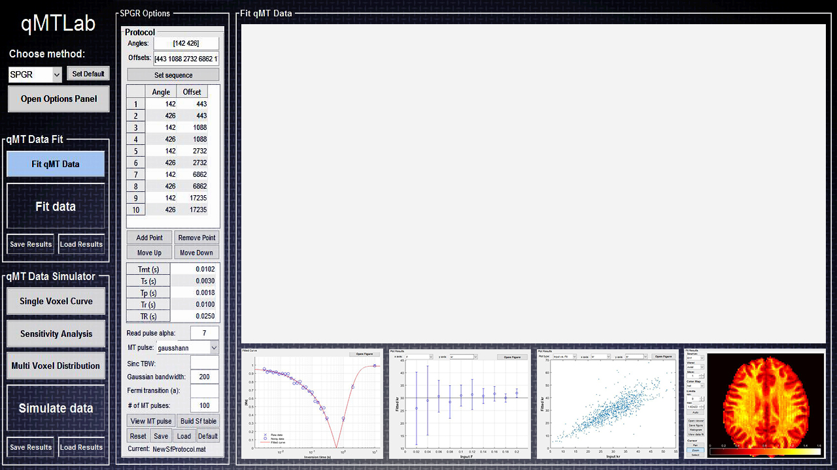



Quantitative Magnetization Transfer Imaging Made Easy with
ISMRM 2016, Singapore
e-poster #3205
qMTLab
Open Source Software for qMTI Data Simulation, Analysis and Visualization
Cabana, J.-F.¹, Gu, Y.², Boudreau, M.³, Levesque, I. R.⁴, Atchia, Y.⁵, Sled, J. G.^{5,6}, Narayanan, S.³, Arnold, D. L.³, Pike, G. B.^{3,7}, Cohen-Adad, J.⁸, Duval, T.⁸, Vuong, M.-T.⁸ and Stikov, N.^{8,9}
¹University of Montreal, Montreal, QC, Canada; ²NeuroRX, Montreal, QC, Canada; ³Montreal Neurological Institute, Montreal, QC, Canada; ⁴McGill University, Montreal, QC, Canada; ⁵University of Toronto, Toronto, ON, Canada; ⁶Hospital for Sick Children, Toronto, ON, Canada; ⁷University of Calgary, Calgary, AB, Canada; ⁸Ecole Polytechnique, Montreal, QC, Canada; ⁹Montreal Heart Institute, Montreal, QC, Canada

Slide 2
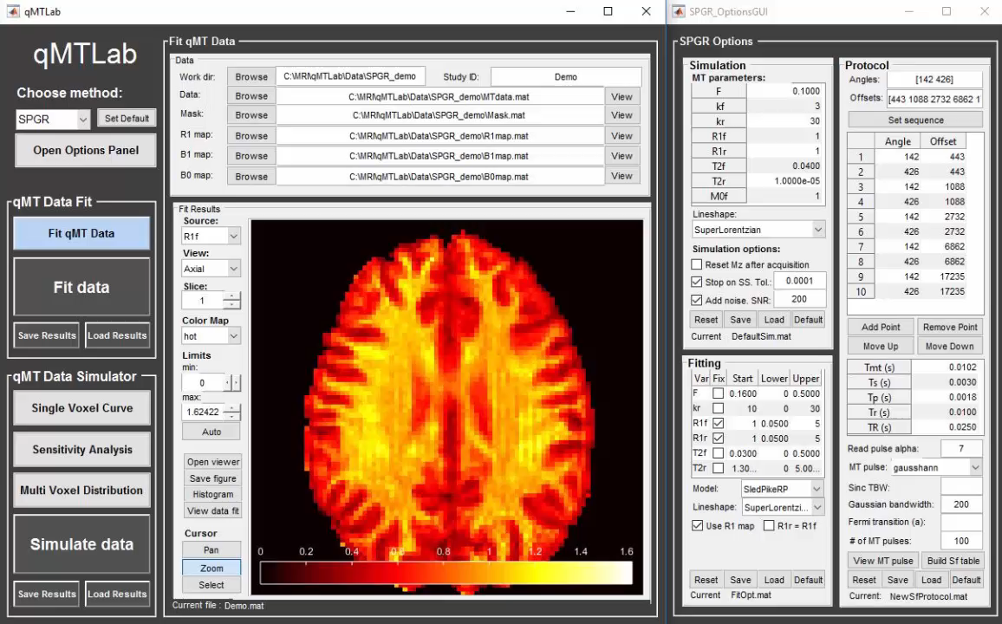
What is qMTLab
qMTLab is a set of tools with a graphical user interface (GUI) for quantitative magnetization transfer imaging (qMTI) data fitting, visualization, analysis and simulation
Open source
Flexible
Easy to use
Built in MATLAB
For more info on qMTI and qMTLab, see our 2016 paper [1]
Cabana et al (2016). Quantitative magnetization transfer imaging made easy with qMTLab : Software for data simulation, analysis, and visualization. Concepts Magn. Reson.. doi: 10.1002/cmr.a.21357
/17

Slide 3
Why we developed qMTLab
Quantitative magnetization transfer imaging (qMTI) offers a distinct contrast mechanism sensitive to tissue molecular composition
Allows extraction and quantification of distinct tissue characteristics with high reproducibility and specificity to macromolecular content
However, its use has been mostly restricted to researchers that have developed these methods, in part due to the need to write complicated in-house software for modeling and data analysis.
Our objective
By providing free software that gives end users a simple and easy to use graphical interface, we hope to make qMTI accessible to a greater number of investigators and facilitate the development, evaluation and optimization of acquisition protocols and analytical models.
/17

Slide 4
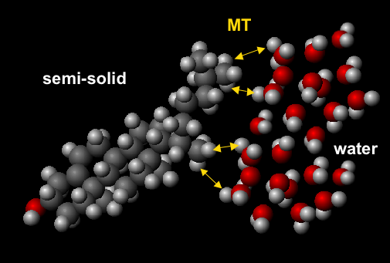
What is magnetization transfer imaging
Magnetization transfer (MT) refers to the interaction between freely moving protons and restricted protons bound to macromolecules
By modeling the exchange process between the liquid and the macromolecular pool of protons, qMTI allows the measurement of precise information about tissue composition
Fraction of the restricted to free pools
MT exchange rate
Relaxation rates
/17

Slide 5
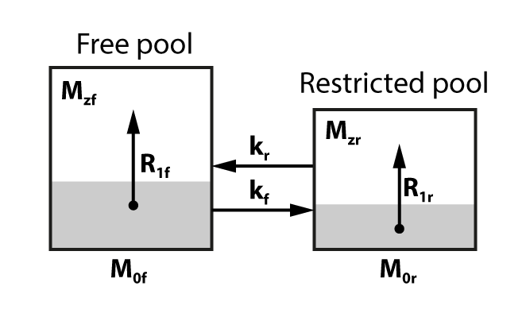
The two-pool model
Most qMTI methods are based on the two-pool tissue model [2], characterised by seven independent parameters:
F - pool size ratio ( = M_{0r}/M_{0f})
k_{f} - forward exchange rate
R_{1f} - free pool longitudinal relaxation rate ( = 1/T_{1f})
R_{1r} - restricted pool longitudinal relaxation rate ( = 1/T_{1r})
T_{2f} - free pool transverse relaxation time
T_{2r} - restricted pool transverse relaxation time
M_{0f} - free pool equilibrium magnetization
Two additional dependent parameters
k_{r} - reverse exchange rate ( = k_{f}/F)
M_{0r} - restricted pool equilibrium magnetization ( = F x M_{0f})
A signal equation is fitted to the data to extract these parameters
[2] R. M. Henkelman et al., MRM, 1993
/17

Slide 6
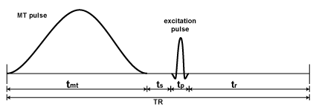
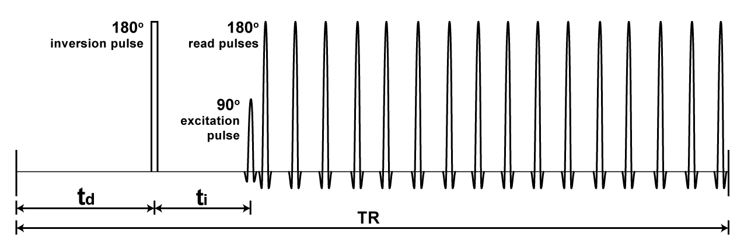
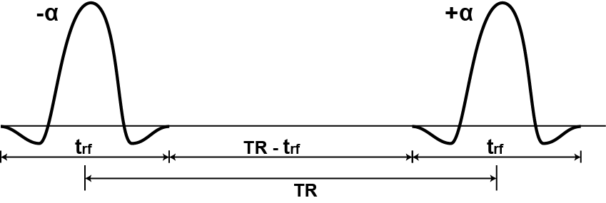
Acquisition methods
MT-SPGR
qMTLab currently supports the most widely used acquisition methods and analytical models
MT-SPGR
Combines off-resonance pulsed saturation of the restricted pool with an SPGR readout [3]
Vary MT pulse duration (t_{mt}) and power (α_{mt})
SIR-FSE
Uses a selective inversion recovery sequence followed by a fast spin echo readout [4]
Vary inversion time (t_{i}) and/or delay time (t_{d})
MT-bSSFP
bSSFP induces a significant MT effect when large flip angles and short TR are used [5]
Vary flip angle (α) and RF pulse duration (t_{rf})
SIR-FSE
MT-bSSFP
[3] Pike, MRM, 1996.; [4] Gochberg et al. MRM, 1999; [5] Bieri and Scheffler, MRM, 2007
/17

Slide 7
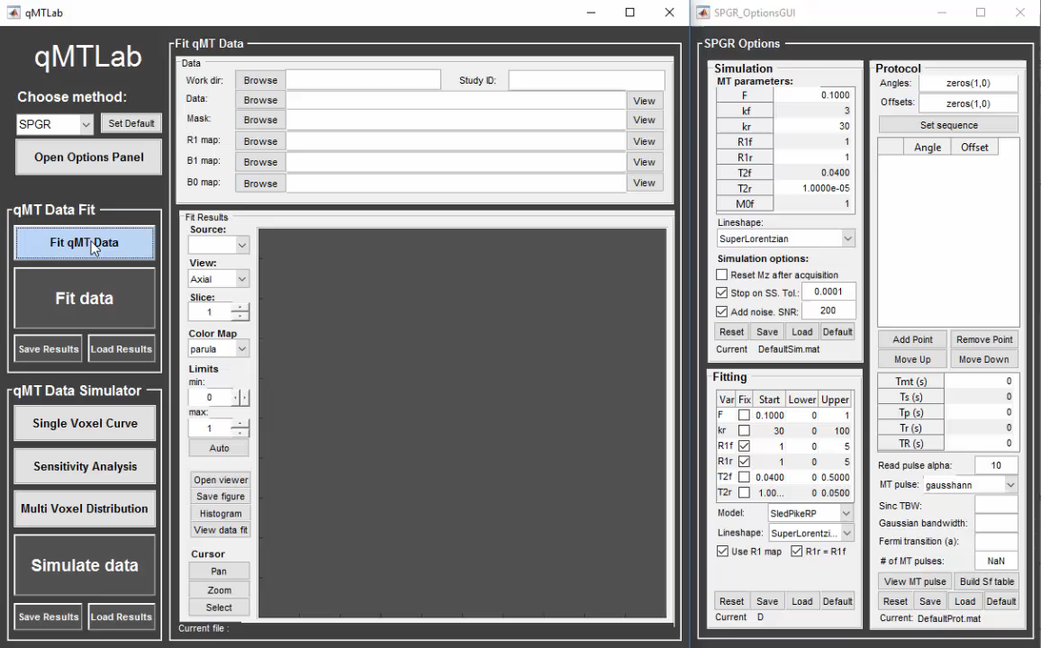
Data fitting with qMTLab
qMTLab provides a convenient interface to fit your qMTI data and visualize the parameters maps
First define or load your acquisition protocol parameters, using the Options panel
Once set, protocol can be saved for later use
Useful tip : Replace the “DefaultProt.mat” file with your preferred protocol to have it automatically loaded when you launch qMTLab
/17

Slide 8
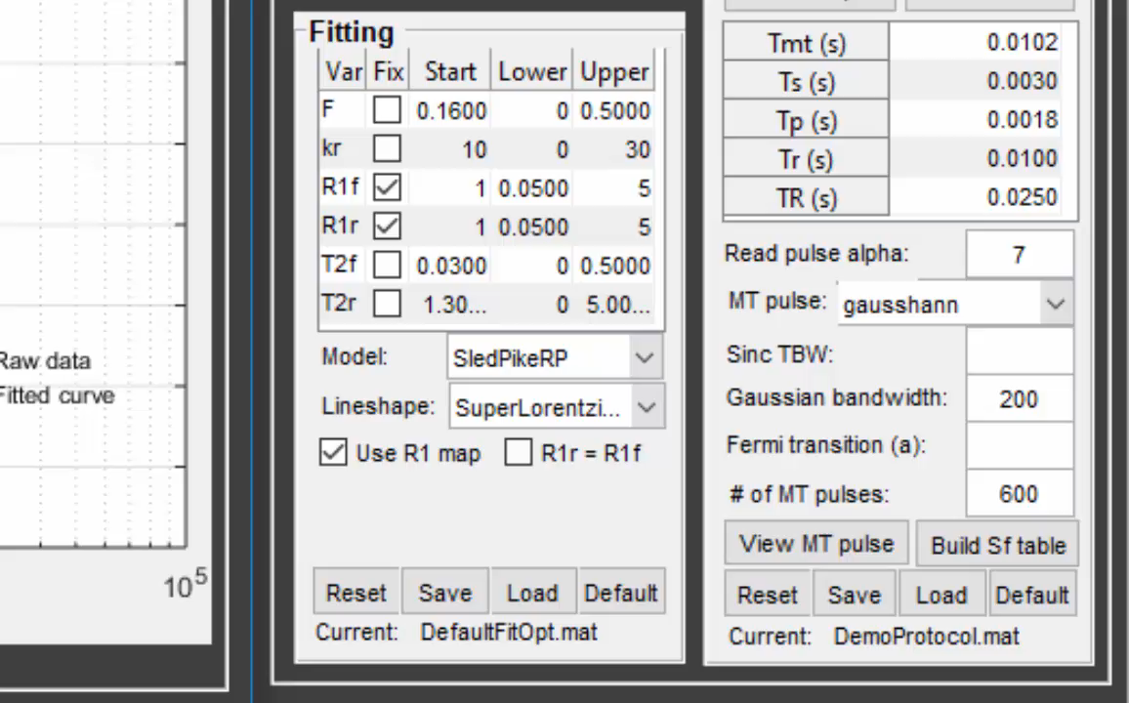
Easy configuration of fitting options
Use default fitting options or experiment with your own
Choose the model you want to use
Select the lineshape of the restricted pool (Gaussian, Lorentzian, SuperLorentzian)
Keep certain parameters fixed
R1r : Fix to a certain value, set = R1f, or fit
Set starting search point
Define lower and upper bounds
Save your preferences for later use
Useful tip : Replace the “DefaultFitOpt.mat” file with your preferred fitting options to have them automatically loaded when you launch qMTLab
/17

Slide 9

Importing your data
Load your qMTI data
Preview your maps for quality control
Test the fitting on selected voxels
Hit the « Fit Data » button
Results are saved in your working directory as a single .mat file and separate maps as .nii files
Useful tip : Put all your files in the same directory and select it as your « Work dir. » -> All the files,protocol and fitting options are loaded automatically
/17

Slide 10
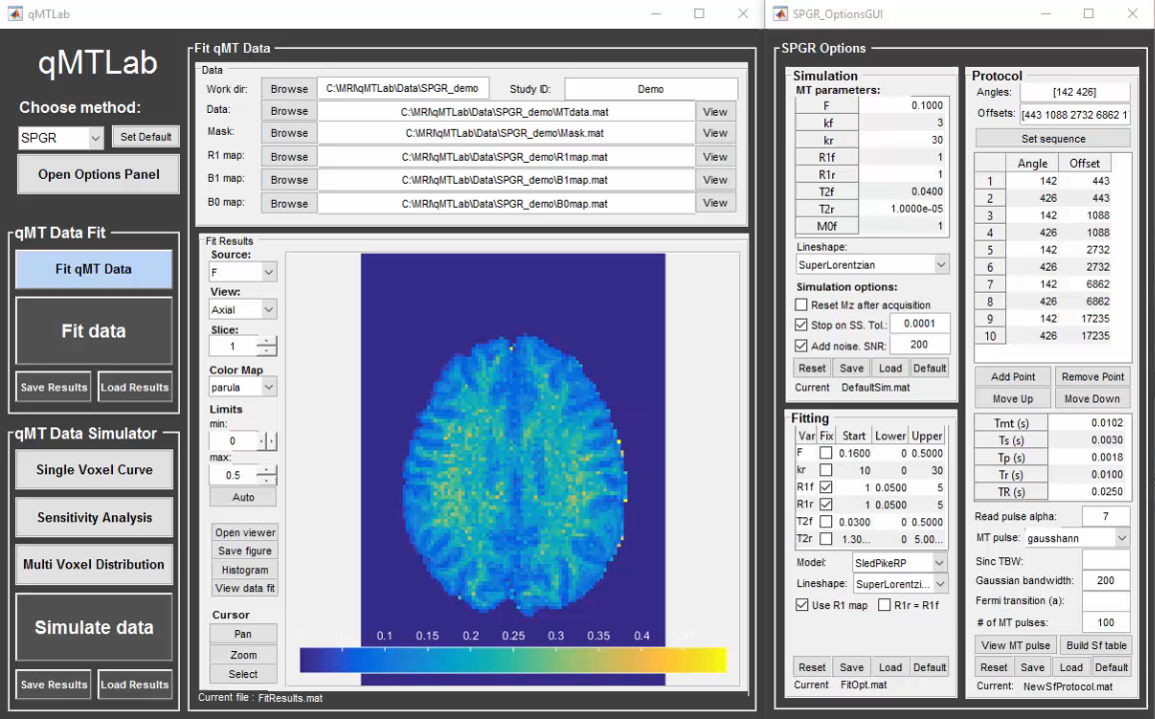
Fit results visualization
View the fitted parameters maps directly in qMTLab
Choose parameter to display
Change color map (color scheme, limits)
View parameter distribution histogram
View selected voxel value
View selected voxel data + fitted curve
Useful tip : When working with 3D data, click « Open viewer » to open a viewer with 3 simultaneous orthogonal views and easier volume navigation
/17

Slide 11
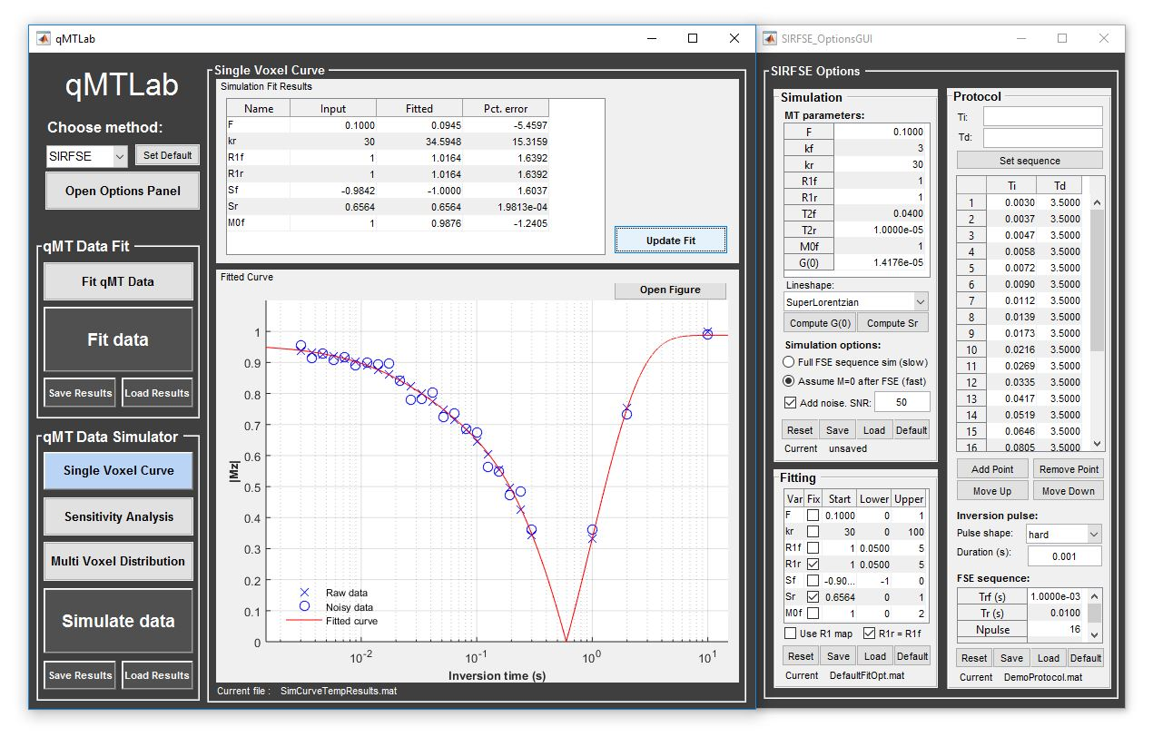
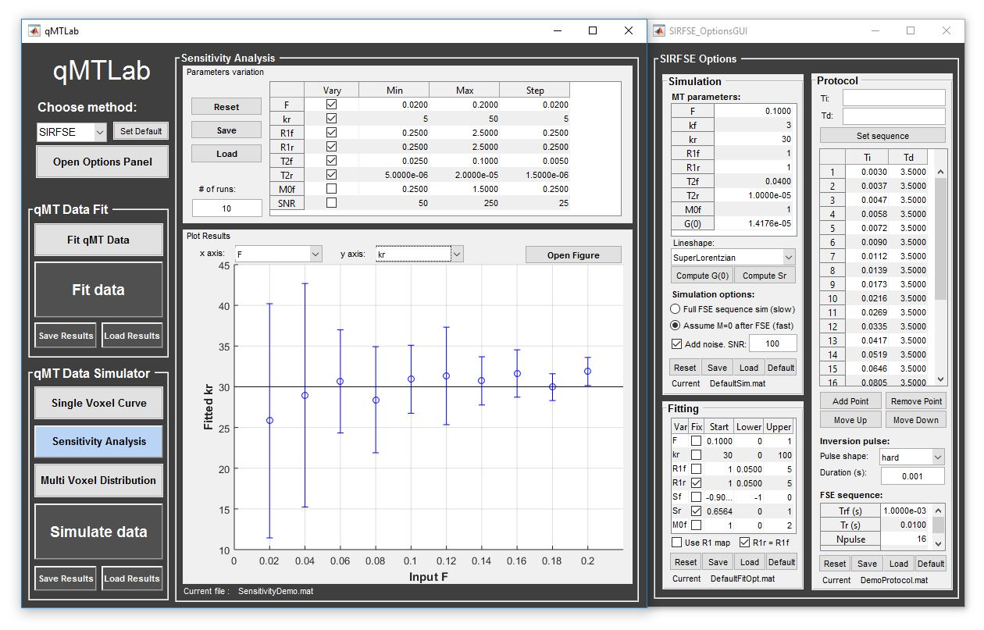
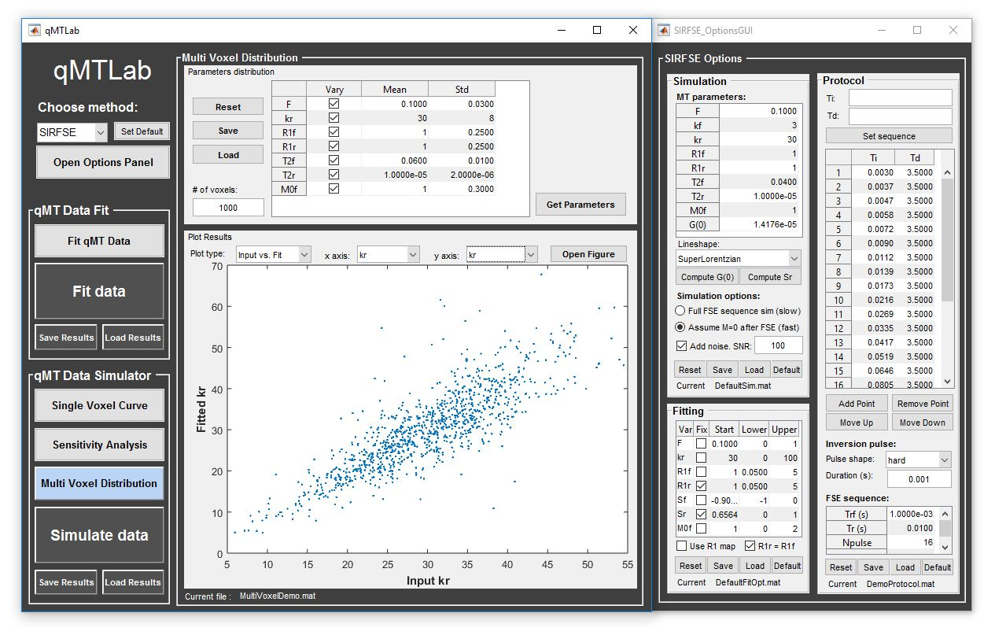
Data simulation
The simulation part of qMTLab is useful for researchers to:
Generate synthetic qMTI data
Evaluate how well the different methods/models perform under known ground-truth
Determine the most appropriate acquisition parameters
Evaluate how fitting options and constraints impact the results
Three modes of simulation:
Single Voxel Curve
Sensitivity Analysis
Multi Voxel Distribution
/17

Slide 12
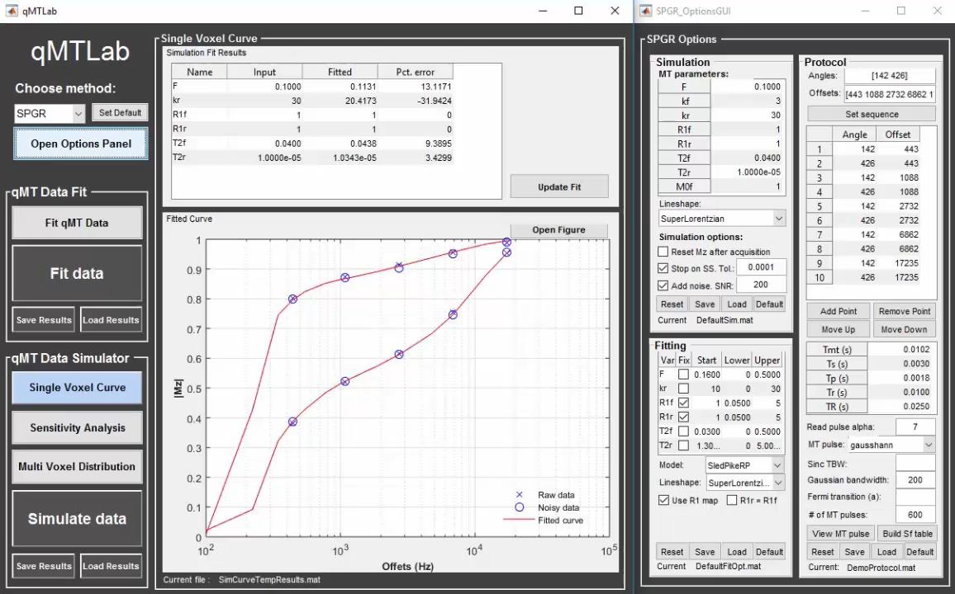
Single Voxel Curve
Simulate MT data for a single voxel
Evaluate various acquisition protocols, the performance of the model and fitting options
The model is fitted and a plot displays
Raw data
Data with added Gaussian noise
Fitted curve
Input MT parameter values, fitted parameters values and percentage difference are listed in a table
Useful tip : You can change fitting options or generate a new set of noisy data and re-fit without having to run the simulation again by simply clicking on « Update Fit »
/17

Slide 13
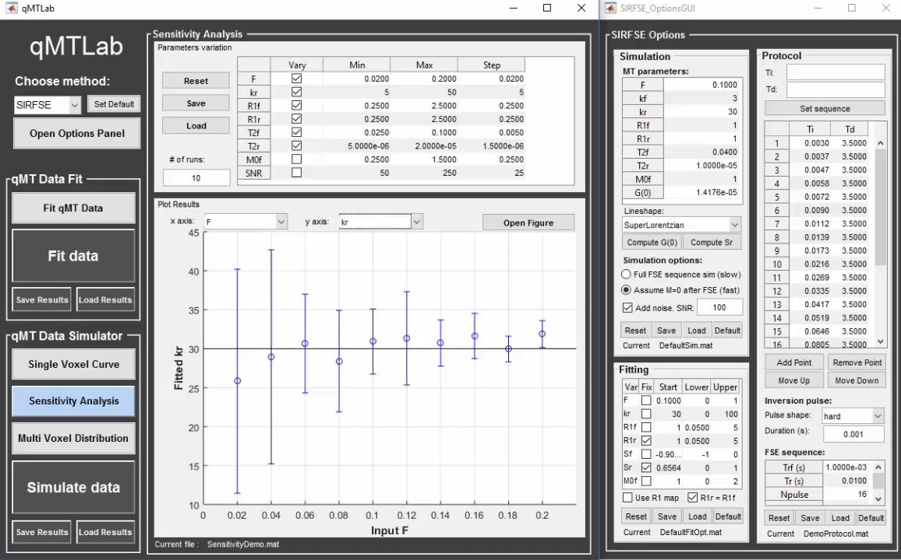
Sensitivity Analysis
Systematically vary one MT parameter at a time while keeping the others fixed
Select which parameters to vary
Set minimum/maximum values and step size
Gaussian noise is added and the fit is run multiple times (set with « # of runs »)
Select the independent and dependant variables to see how the variation of one affects the other
/17

Slide 14
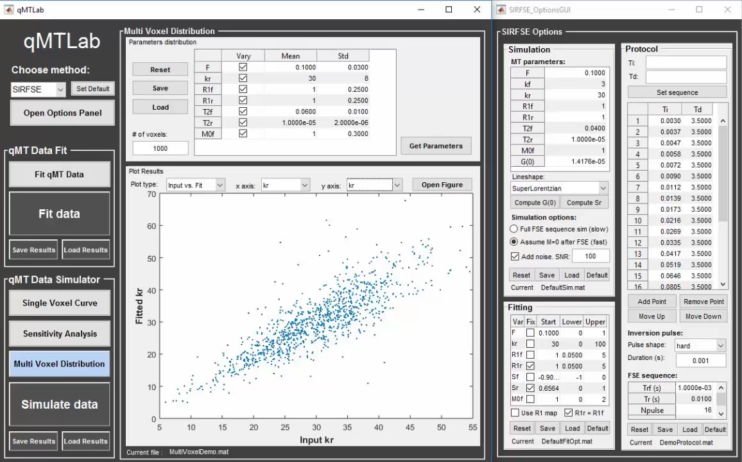
Multi Voxel Distribution
Any parameter combination is allowed to be varied simultaneously
Choose the number of voxels
Select which parameters to vary
Set mean value and variance for each parameter
Analyze results in a number of ways
Histograms
Scatter plots of input vs fitted parameters
Error histograms
Bar graphs (RMSE, NRMSE, MPE)
/17

Slide 15
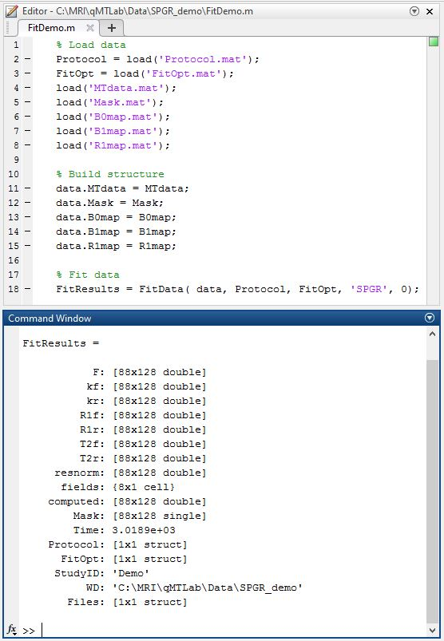
Integrating qMTLab in your pipeline
No complicated installation procedure or dependencies
Just add qMTLab folder to your MATLAB path
Use in MATLAB scripts
Fit = FitData(data, Protocol, FitOpt, Method)
data is a structure with fields 'MTdata', and optionally 'Mask','R1map','B1map','B0map'
Protocol is a protocol structure saved from the qMTLab Options panel
FitOpt is a fitting options structure saved from the qMTLab Options panel
Method selects ‘SPGR’, ‘SIRFSE’ or ‘bSSFP’
qMTLab GUI can load .mat or .nii files
Includes external tools for file conversion
Tools for NIfTI and ANALYZE image (by Jimmy Shen)
DICOM to NIfTI converter, NIfTI tool and viewer (by Xiangrui Li)
/17

Slide 16
What’s coming up
Additional MT methods
MTsat
MTR
Parallel computing support
Faster data fitting / simulation
Your own contribution
Comments, suggestions and improvements are welcome on the GitHub repository
Download qMTLab for free :
https://github.com/neuropoly/qMTLab/
For more info on qMTI and qMTLab, see our 2016 CMR paper
Cabana et al (2016). Quantitative magnetization transfer imaging made easy with qMTLab : Software for data simulation, analysis, and visualization. Concepts Magn. Reson.. doi: 10.1002/cmr.a.21357
/17

Slide 17
References
[1] J.-F. Cabana, Y. Gu, M. Boudreau, I. R. Levesque, Y. Atchia, J. G. Sled, S. Narayanan, D. L. Arnold, G. B. Pike, J. Cohen-Adad, T. Duval, M.-T. Vuong, and N. Stikov, “Quantitative magnetization transfer imaging made easy with q MTL ab : Software for data simulation, analysis, and visualization,” Concepts Magn. Reson.. doi: 10.1002/cmr.a.21357.
[2] R. M. Henkelman, X. Huang, Q. S. Xiang, G. J. Stanisz, S. D. Swanson, and M. J. Bronskill, “Quantitative interpretation of magnetization transfer,” Magn Reson Med, vol. 29, no. 6, pp. 759–766, 1993.
[3] G. B. Pike, “Pulsed magnetization transfer contrast in gradient echo imaging: A two-pool analytic description of signal response,” Magn. Reson. Med., vol. 36, no. 1, pp. 95–103, 1996.
[4] D. F. Gochberg, R. P. Kennan, M. D. Robson, and J. C. Gore, “Quantitative imaging of magnetization transfer using multiple selective pulses,” Magn Reson Med, vol. 41, no. 5, pp. 1065–1072, 1999.
[5] O. Bieri and K. Scheffler, “Optimized balanced steady-state free precession magnetization transfer imaging,” Magn Reson Med, vol. 58, no. 3, pp. 511–518, 2007.
Contact info: jean-francois.cabana@umontreal.ca
/17

